Slide 1
K.E.E.S.
Keyless Electronic Entry System
Group 17
Chris Condella, EE
Jason Wagner, CpE
Joshua Baxter, CpE
Samuel Demole, CpE
Notes:
add picture ?

Slide 2
Motivation
Home Automation/Access Control is a trending technology in the commercial market
Improve on home monitoring and surveillance systems
Opportunity to learn and implement multiple hardware and software technologies

Slide 3
Goals and Objectives
Remote door access and guest management system
Remote control via web interface
Enable multiple methods of entry to home
Allow specific guests access to home

Slide 4
Specs & Requirements
KEES camera module will display a live video feed with no more than 5s delay @ 2fps
KEES system will allow the user to add a guest to the Face database
KEES system will allow the user to remove a person in the Face database
KEES face recognition will recognize a guest within 5s
KEES RFID module will unlock door instantly upon scanning a valid RF tag from within 3in away
KEES piezoelectric sensor will recognize a custom knock within 3s
KEES system voltage and current will require 5 VDC @ ~5A
KEES battery backup will last up to approx. 8 hrs

Slide 5
Block Diagram
Knock Detector
Browser/App
MCU
SoC
RFID Reader
Server
Electric Strike
Power Supply
Camera
Notes:
Overview

Slide 6
State Diagram
Active
Locked
Waiting for Face
Listen for Unlock request from WebApp
Face not
Recognized &
2.5 sec Timeout
Attempt to Recognize Face
10 sec
Timeout
Face
Recognized
Unlock
via WebApp
Listen for RFID /
Detect Knock Pattern
2 sec
Timeout
Valid
RFID
Valid
Knock Pattern
Door Unlocked

Slide 7
mcu
Knock Detector
Browser/App
MCU
SoC
RFID Reader
Server
Electric Strike
Power Supply
Camera
Notes:
Overview

Slide 8
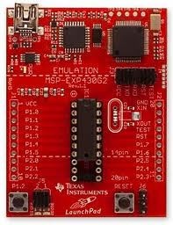
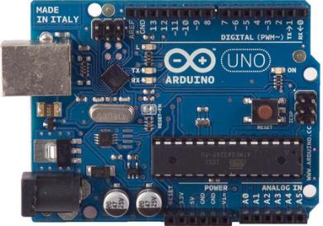
ATMega328 vs Msp430
 | ATMega328 | MSP430F2XX
CPU | 20MHz | 16 MHz
Flash Size | 16 KB | 1–120 KB
GPIO | 28 | 10-48
Power Req. | 3.3-5 V | 1.8-3.6 V

Slide 9
Electric strike
Knock Detector
Browser/App
MCU
SoC
RFID Reader
Server
Electric Strike
Power Supply
Camera
Notes:
Overview

Slide 10
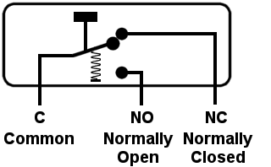
Types of electric strikes
Normally Closed (NC)
  Strike is locked when no electric current is applied
  Fail Secure
Normally Open (NO)
  Strike is locked when electric current is applied
  Fail Safe

Slide 11
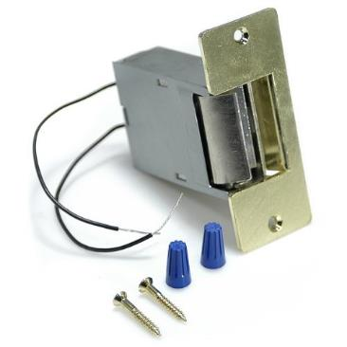
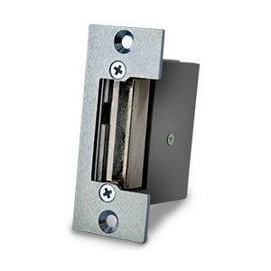
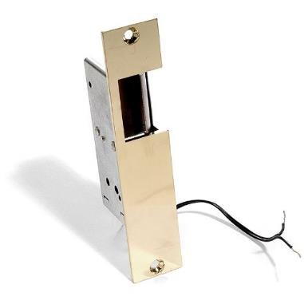
Electric strike
 | Lee Electric | Rutherford | Lee Electric
Voltage | 3-6 VDC | 12 VDC | 12VDC
Ohms | ~ 2.7 | 3.5 | 4
Current | ~1.8 A | ~3 A | ~2.5 A
Price | $40 | $50 | ~$33

Slide 12
LEE Electric Strike

Slide 13
Rfid module
Knock Detector
Browser/App
MCU
SoC
RFID Reader
Server
Electric Strike
Power Supply
Camera
Notes:
Overview

Slide 14
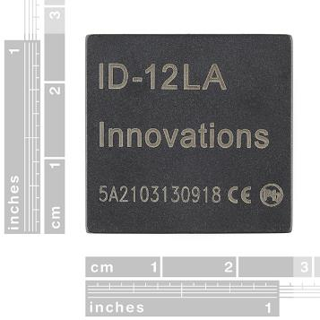
RFID MODULE
Purpose:
Allow Entry through the door
Put system into Programming mode using MASTER key
Add/Remove RFID cards
EM4001 64-bit RFID card compatible
ID-Innovations
ID-12LA
 | ID-12LA
Range | 3”- 5” inches
Frequency | 125 kHz
Power Req. | +2.8 VDC to +5 VDC
Card Format | EM 4001 or compatible
Price | $29.95

Slide 15
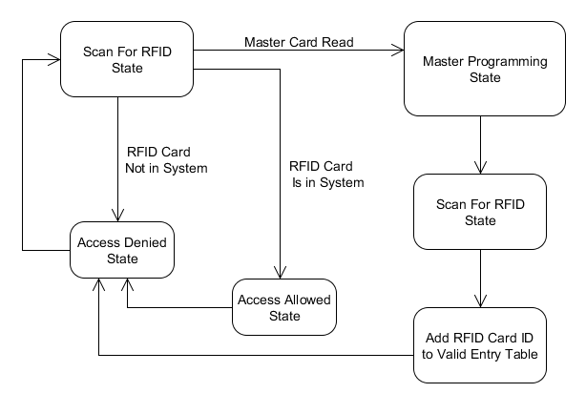
Rfid state diagram

Slide 16
Knock detector
Knock Detector
Browser/App
MCU
SoC
RFID Reader
Server
Electric Strike
Power Supply
Camera
Notes:
Overview

Slide 17
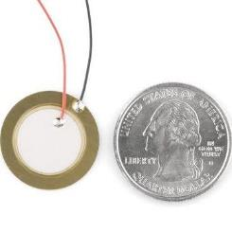
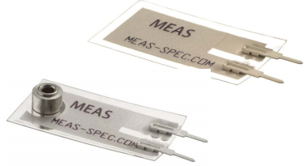
Piezo electric sensor
Purpose:
When Piezo material is deformed a charge is sent over terminals
Detect secret knock and allow entry through the door
Add/Remove Secret knocks

Slide 18
Knock detection state diag
Knock
Detected
Master Card
Swiped
Programming State
Storing Knock Parameter
Knock
Detected
Waiting for Knock
Storing Knock Parameter
Unlock Door
Validating Knock
Update Secret Knock

Slide 19
soc
Knock Detector
Browser/App
MCU
SoC
RFID Reader
Server
Electric Strike
Power Supply
Camera
Notes:
Overview

Slide 20
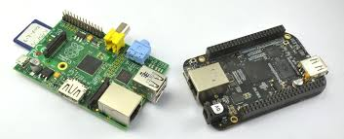
Beaglebone vs raspberry pi
 | BeagleBone Black | Raspberry Pi
Base Price | $45 | $35
Processor | 1GHz TI Sitara AM3359 ARM Cortex A8 | 700 MHz ARM1176JZFS
RAM | 512 MB DDR3L @ 400 MHz | 512 MB SDRAM @ 400 MHz
Storage | 2 GB on-board eMMC, MicroSD | SD
GPIO Capability | 65 Pins | 8 Pins
Peripherals | 1 USB Host, 1 Mini-USB Client, 1 10/100 Mbps Ethernet | 2 USB Hosts, 1 Micro-USB Power, 1 10/100 Mbps Ethernet, RPi camera connector

Slide 21
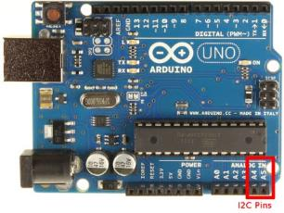

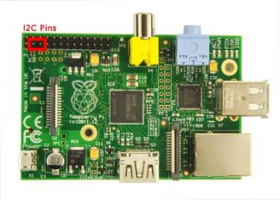
MCU – soc communication
Implementing I2C between ATMega and Pi
State scripting protocol is sent over I2C bus for updating and control

Slide 22
Camera
Knock Detector
Browser/App
MCU
SoC
RFID Reader
Server
Electric Strike
Power Supply
Camera
Notes:
Overview

Slide 23
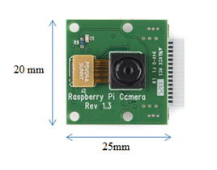
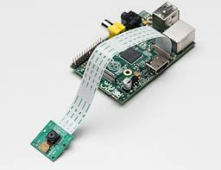
Raspberry Pi Camera
Connects via CSI on Raspberry Pi
Higher frame rate due to reduced latency: uses small amount of CPU
Webcams have higher latency
Picamera 1.3
  Python SDK captures frames from Raspberry Pi camera

Slide 24
IMG Processing & streaming Features
Detect faces
Learn a face within 10 seconds
Recognize specified faces within 5 seconds
Categorize non-guests as ‘unrecognized’
Save snapshot of a frame in 320x240
Provide JPEG video stream viewable over the internet

Slide 25
IMG PROCESSING & Streaming
OpenCV 2.4.6
  Face Recognition and Detection API
    Local Binary Patterns Histogram
  Optimized preprocessing functions
    Canny and Binary Histogram
  Numerous image processing capabilities
MJPEG Streamer
  Capture camera frames as .jpeg
  Very little CPU usage: only 1%
  Sends frames to a specified IP addresss

Slide 26
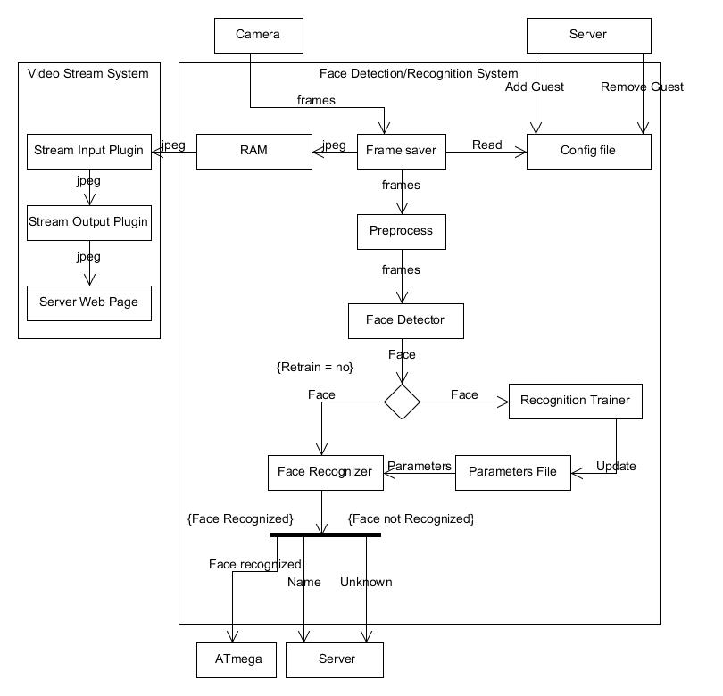
Img Processing & Streaming

Slide 27
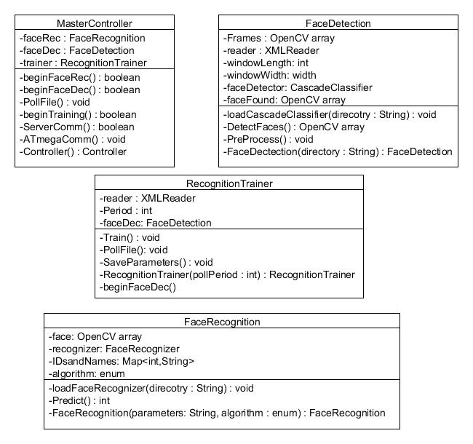
Img Processing Class Diagram

Slide 28
ServeR / WEBAPP
Knock Detector
Browser/App
MCU
SoC
RFID Reader
Server
Electric Strike
Power Supply
Camera
Notes:
Overview

Slide 29

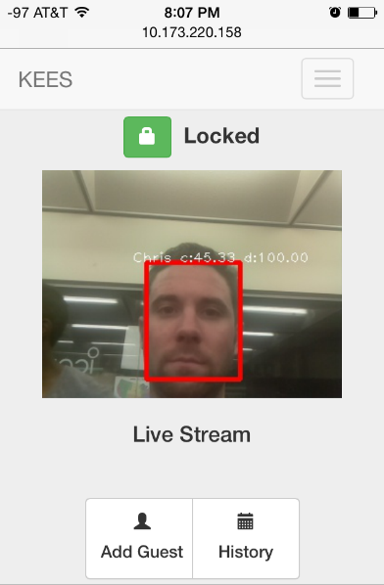
WebApp Features
Lock Status
Unlock Door
View Live Stream
View History
Add/Remove Guests
System Master Mode

Slide 30

WebApp (Frontend UI)
Bootstrap 3.0 framework
  Responsive design
  Numerous HTML/CSS templates
  Cross-platform support
jQuery
  Most popular JS library
  Used by 65% of top 10,000 visited sites
HTML
CSS

Slide 31


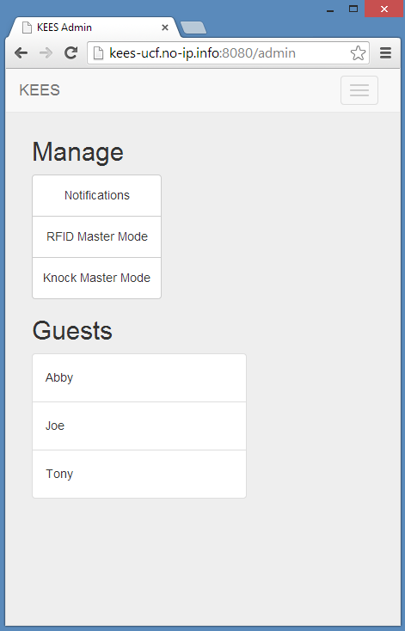
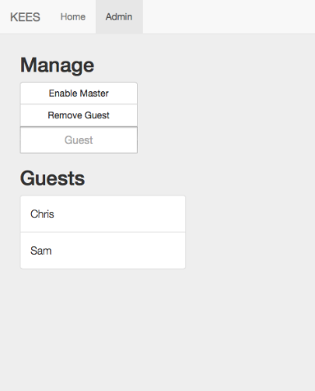
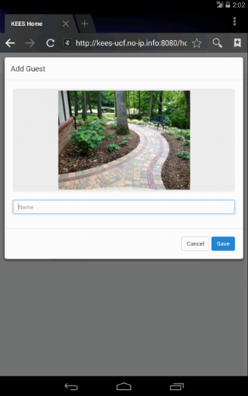
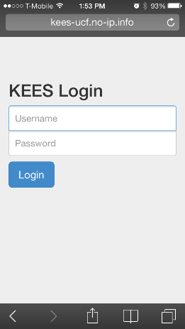
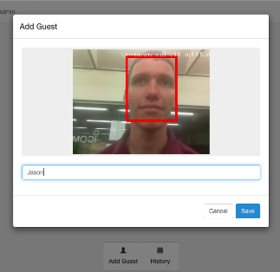
WebApp UI

Slide 32

WebApp (Backend)
Node.js - Webserver
  Express
  jade
NPM - Node.js Package Manager
Logging
  Event History
  Guest Information
Git - Version Control
MJPEG-Streamer
Python Scripts
Listener
Send Command
Add Guest
Dynamic DNS (noip.com)

Slide 33
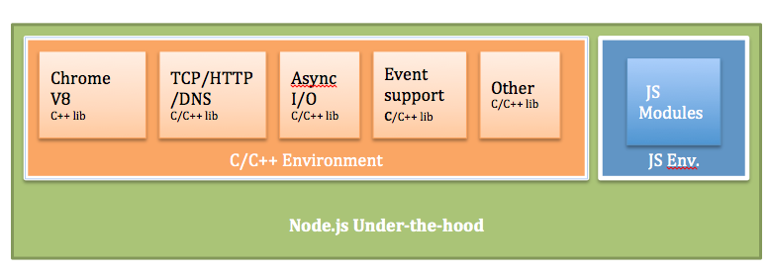
WebApp - Node.js
Single threaded, event-driven, non-blocking
High scalability
Lightweight
Pure JavaScript (No Apache/XML/PHP/MySQL)
Google V8 JavaScript Engine
Used by PayPal, Microsoft, LinkedIn, Yahoo!

Slide 34
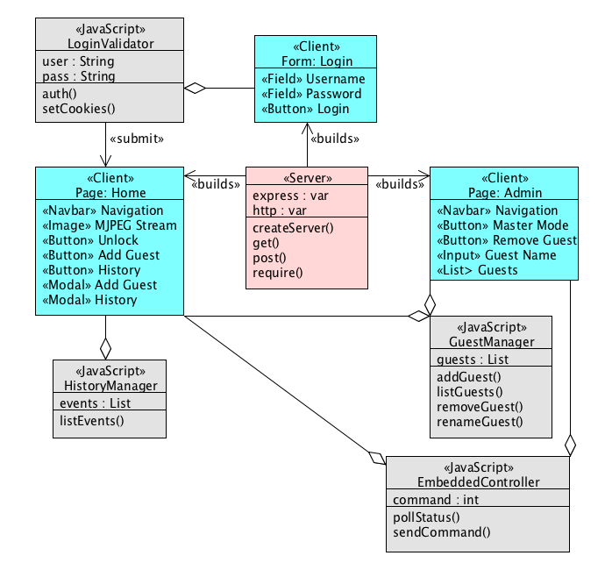
WebApp UML

Slide 35
Power
Knock Detector
Browser/App
MCU
SoC
RFID Reader
Server
Electric Strike
Power Supply
Camera
Notes:
Overview

Slide 36
Operating Characteristics
Component | Voltage Required | DC current Draw
Strike | 3 VDC min | 1.1-2.2 A
RFID | 4.6-5.4 VDC | 30 mA
Atmega328 | 3.3/5 VDC | Per I/O pin ~40mA
 |  | VCC/GND pins ~200mA
Raspberry Pi | 5 VDC | 0.7 – 1 A
Charging Circuit | ~15 VDC | 0.2 - 1A
*The electric strike resistance ~ 2.7 Ω, using V=IR @ 5V, I = ~1.8 A
The entire system will need to be powered with 5VDC @ ~ 4 A or more to be safe. An AC/DC converter will be used to satisfy the 15V charging circuit and 5V regulator to step down the voltage.

Slide 37
Power Block Diagram
AC Power
15 V AC/DC Adapter
Diode OR
PNP
5V Regulator
Battery Pack
Rasp Pi
Strike
Battery Charger
Battery Pack
Diode OR
5V Regulator
Embedded
System

Slide 38
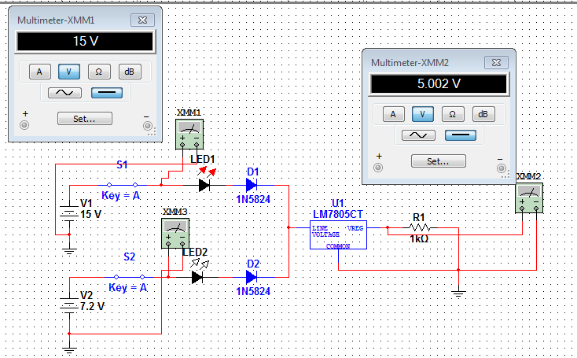
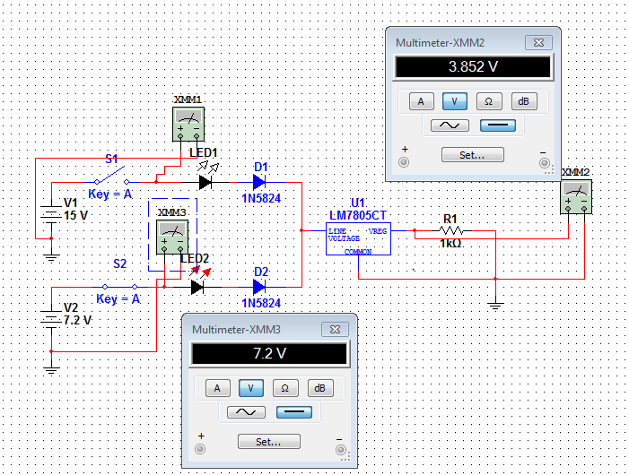
Diode OR-ing
When the 15 VDC source is ON it serves as the main power source for the load.
When the 15 VDC source
is OFF the back up 7.2 VDC source becomes the main power source for the load.

Slide 39
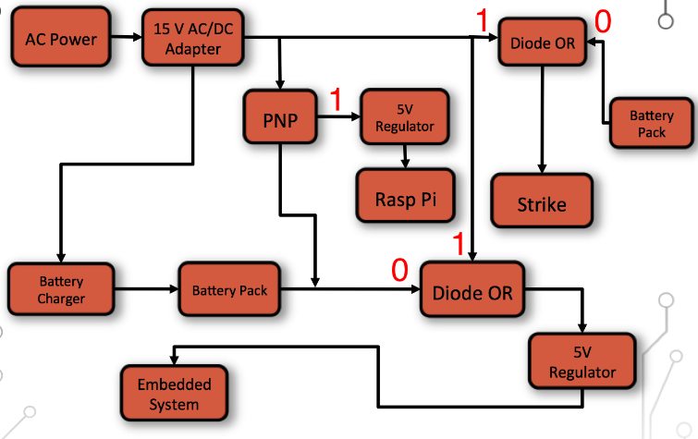

Or-ing Logic
AC Voltage ON
AC Voltage OFF

Slide 40
Device = LM5023MM-NOPB
Topology = Flyback
Vin = 100 – 240 VAC
Vout = 15VDC
Iout= 5A
AC/DC Converter
Designed with TI Webench

Slide 41
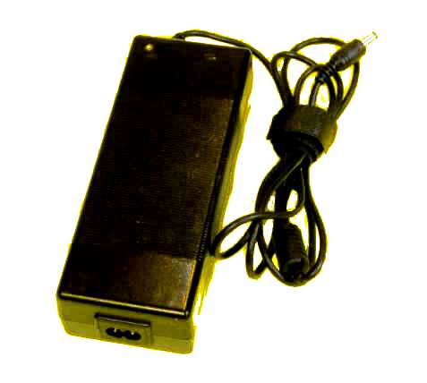
15 VDC, 8.0 a S AC/DC Power Supply
Part Number: PST-AC1580
Output: 15 Volts DC, 8.0 amps
Output Power: 120 Watts max
Input Voltage: 100-240 VAC, 50-60 Hz
Input Frequency: 50-60 Hz
No-load overhead: 200mW
Excellent Efficiency: 80% at half load
78% at full load
Temperature: 0° to 40° C Operating
Size: Approx(1.5 x 2.5 x 6.7 inch)
Weight: 18 oz., 500 gm, 1.1 lbs
Output connector: 6.3 OD x 3.0 ID mm x 12.5mm
Output Polarity: Center Positive
AC plug: Removable IEC connector
*Courtesy of PowerStream.com

Slide 42
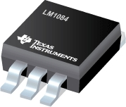


LM1084 5A Low Dropout Positive Regulator
5 VDC regulated
Max dropout of 1.5V
6.5V ≤ Vin ≤ 20V
5A of load current
Current Limiting (8A)
Thermal Protection
Vref ~ 1.25V
*Images from LM1084 pdf

Slide 43
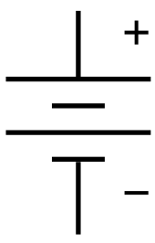
Battery back up
A battery back up will ensure the embedded system will stay powered and active even if main power is lost.
8-10 hour back up should suffice for our project.
We will consider certain battery types and properties such as size, price, availability and convenience etc.

Slide 44
Battery types: rechargeable

Slide 45
Nimh Rechargeable AA Batteries
Charge Time (fully discharged)
(Batt mAh Capacity * 120%)/mA Charge Rate
= Hrs needed to charge
mA Charge Rate | Hrs of Charge
200 | ~43
400 | ~22
500 | ~17
600 | ~14
700 | ~12
900 | ~10
1000 | ~9
* From Energizer NiMH Handbook and App Manual PDF

Slide 46

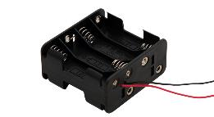
Battery Charging circuit
# of NiMH Cells | Volts Required | R1 Ω | R2 Ω | TM1 Ω
6 | ~15 | 1.2 | 1k | 0 - 10
1.2 V per cell
Approx. 2000-2500 mA-h per battery
2300mA-h x6 gives 7.2VDC with 2.3 A-h
Max Current | 25mA | 50mA | 100mA | 200mA
R1 | 1.2 Ω | 1.2 Ω | 1.2 Ω | 1.2 Ω
TM1 | 4.0 Ω | 3.3 Ω | 1.5 Ω | 1 Ω

Slide 47
PCB
Schematic

Slide 49
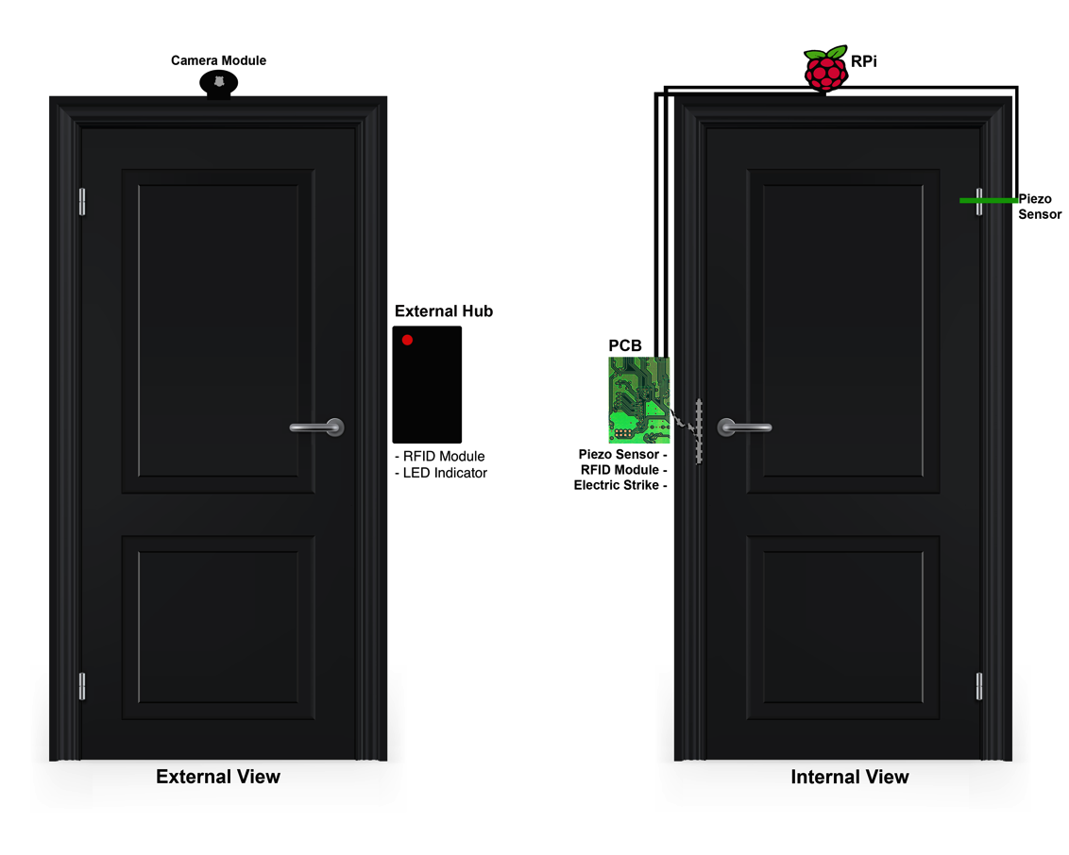
Model

Slide 50
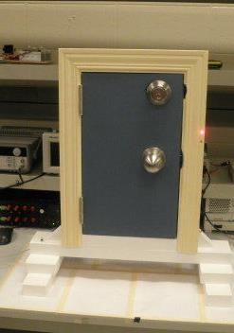
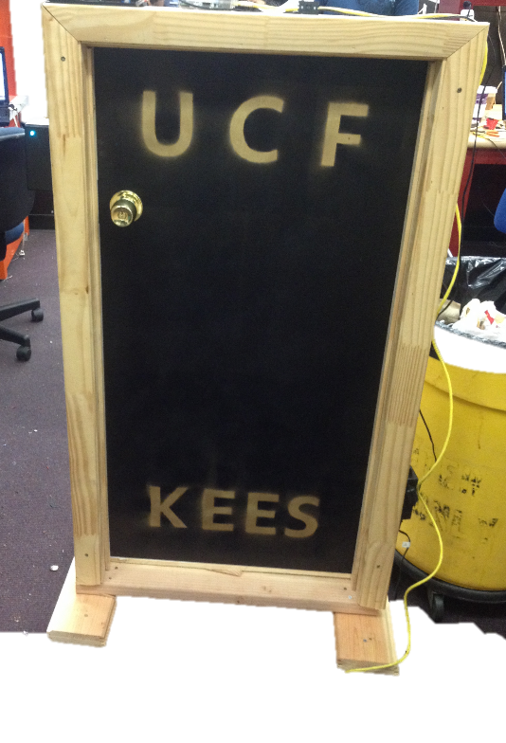
Prototyping

Slide 51
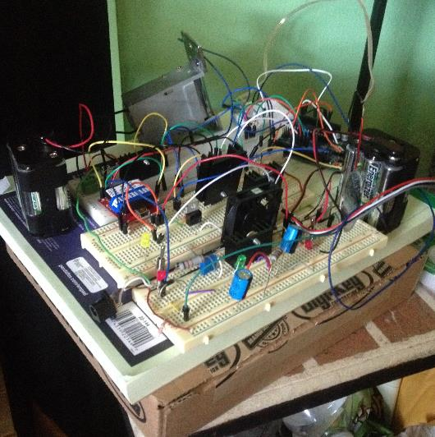
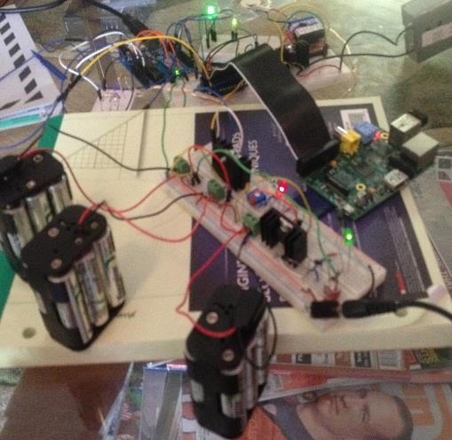
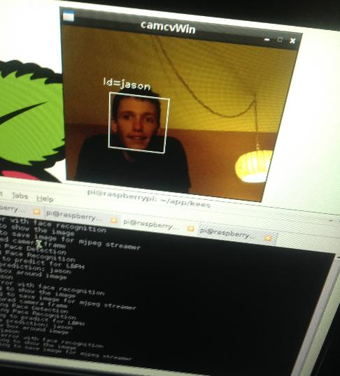
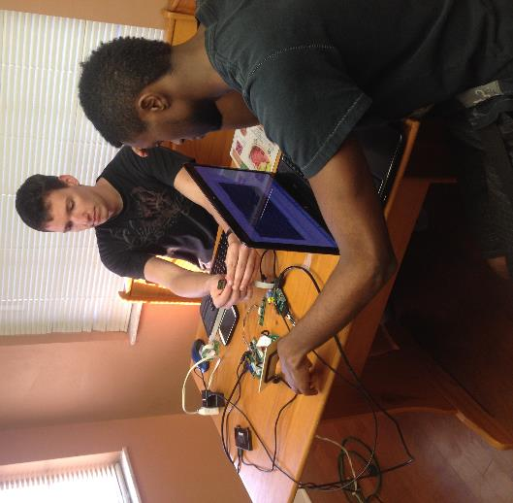

Slide 52
Budget
Item | Cost
AC/DC Adapter | $20
Raspberry Pi | $35
ATMega328 | $20
WiFi Module | $15
Electric Strike | $30
Pi Camera Module | $30
RFID Module | $30
PCB | ~ $50
Battery Backup | ~ $20
Piezo Element | $5
Item | Cost
Prototyping Materials | ~$30
Various Electronic Parts | ~$20
NiMH Batteries | $18
Total | ~$323

Slide 53
Work Distribution
 | Chris | Jason | Josh | Sam
ATMega328 | X | X
Knock Pattern | X | X
Face Recognition |  |  | X
RPi Scripts |  |  | X | X
Server / UI |  |  |  | X
Power | X
RFID |  | X

Slide 54
Issues
Piezo Placement/Sensitivity
Face Detection
Camera Frames
HW/SW Integration
Electric Strike Current Draw

Slide 55
Questions?
Notes:
add picture ?

